Slide 1
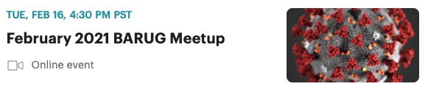
Practical Pins:
Bizops with Salesforce data
Dave Hurst
Director of Business Development
RStudio, PBC

Slide 2
Abstract
As an orchestration language, R enables BizOps by providing a robust set of tools to interrogate, transform, model and visualize data from various business systems in order to better analyze and inform business decisions.
This talk will encompass a brief overview of the pins package, and techniques for accessing Salesforce data. Then we will put these two concepts together to illustrate how the combination enables a transformation in the way your teams can collaborate to store, analyze and report on data. We'll discuss use cases in the wild as well as some examples you can try out yourself using the Salesforce Trailhead training environment.

Slide 3
BizOps
BizOps is a new approach to data-driven decision making that connects your business operations and technology functions together to drive business outcomes. BizOps is a framework that promises to fundamentally change the way your teams collaborate to store, analyze, and report on data.
https://www.broadcom.com/solutions/bizops
Data
+
Processes

Slide 4
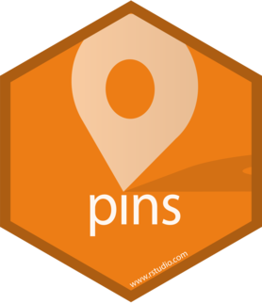
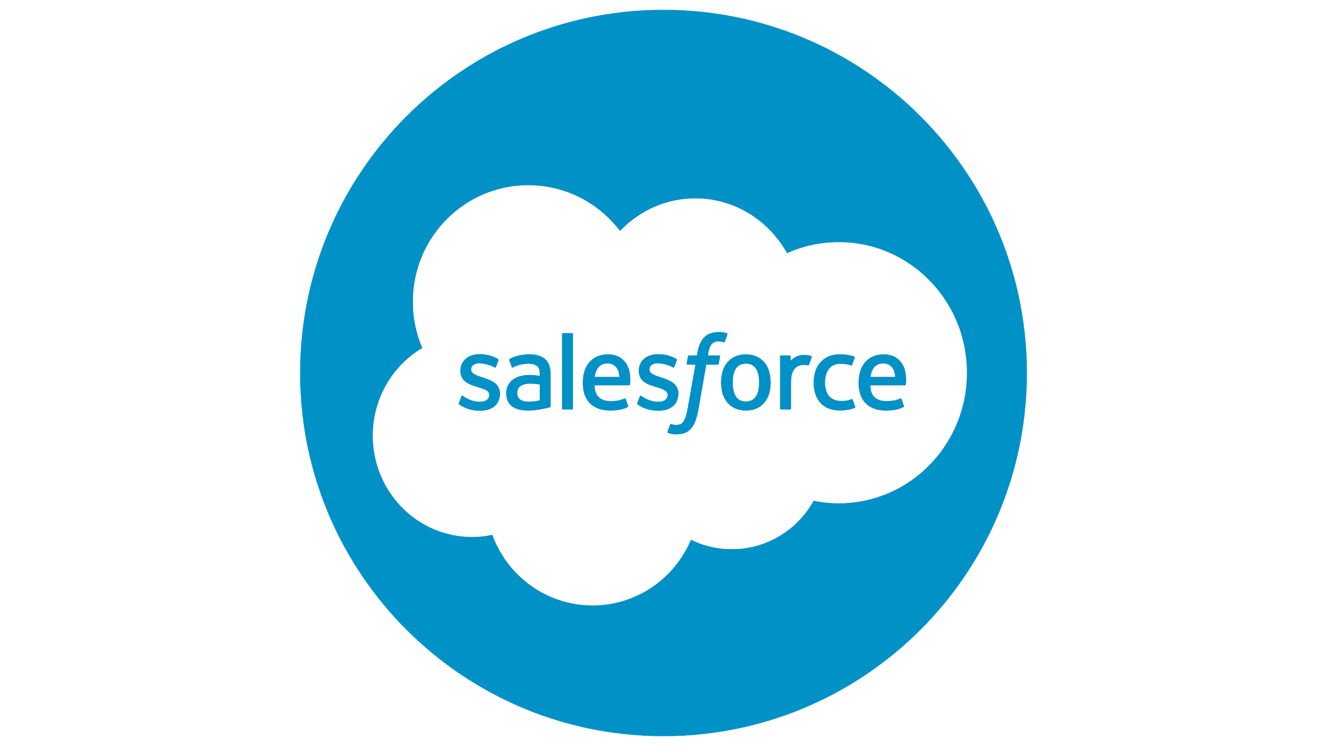
+

Slide 5
What is pins?

Slide 6
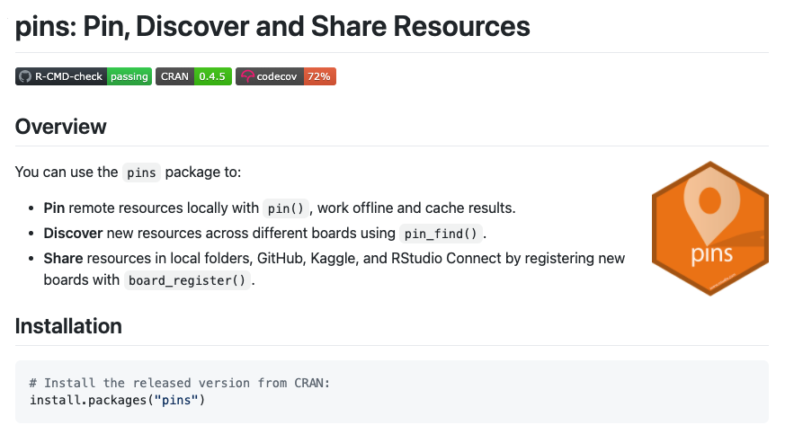
What is pins?
https://pins.rstudio.com/

Slide 7
What ARE pins?

Slide 8
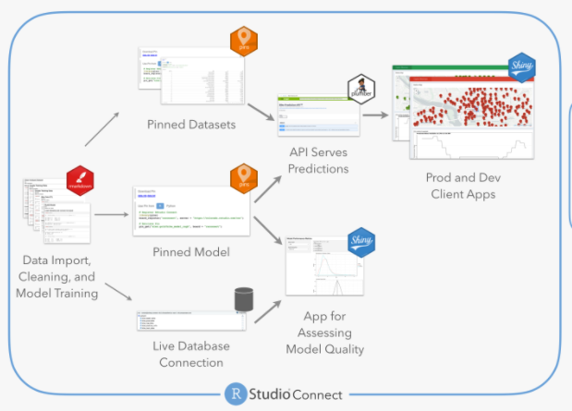
Any R object can be a pin:
files
models
functions
data frames
etc.
https://github.com/sol-eng/bike_predict
Good candidates for pins are:
SMALL ( < 1GB)
REUSED
CURRENT (changing)
“Pins are for things you recreate”

Slide 9
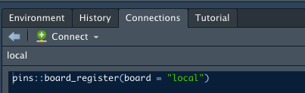
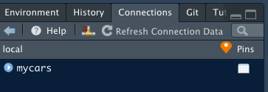
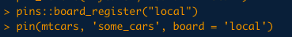
Any R object can be a pin:
files
models
functions
data frames
etc.

Slide 10
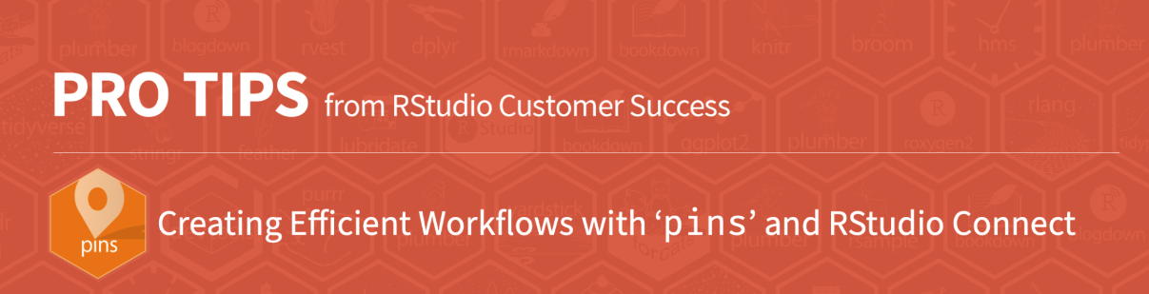
https://pins.rstudio.com/
..., you can share resources with other users by publishing to Kaggle, GitHub, RStudio Connect, Azure, Google Cloud, S3, DigitalOcean or integrate them into your website as well.
https://github.com/rstudio/cs_protips/blob/master/pins_in_rsc/protip_pins/protip_pins.pdf
Example: Bike share model - https://colorado.rstudio.com/rsc/connect/#/apps/3826/access

Slide 11
+

Slide 12


Slide 13
What is Salesforce
Salesforce.com, Inc. is an American cloud-based software company headquartered in San Francisco, California. It provides customer relationship management (CRM) service and also provides a complementary suite of enterprise applications focused on customer service, marketing automation, analytics, and application development.
https://en.wikipedia.org/wiki/Salesforce
Data
Processes

Slide 14
Salesforce Data Model (oversimplified)
Accounts
Billing Country
Owner
ACV*
...
License Keys
License Terms
Owner
...
Opportunities
Product SKUs
Partners
Quotes
Discount
Certification
Line Items

Slide 15
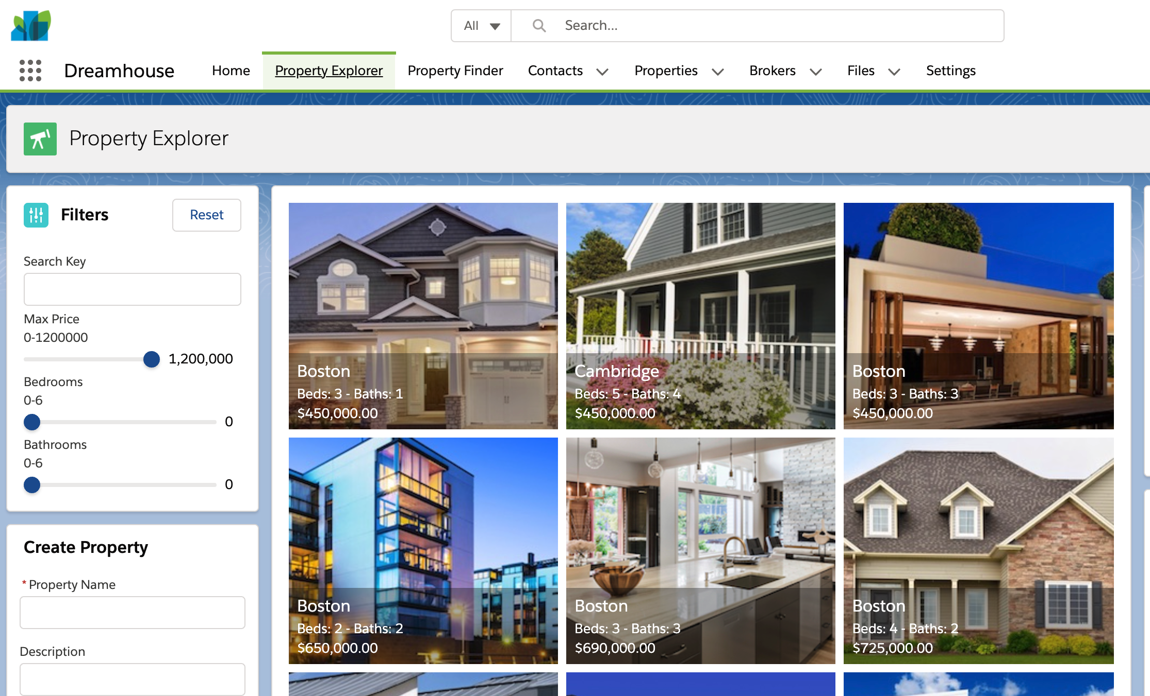

Slide 16

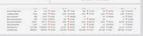

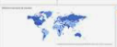
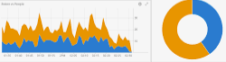
Centralized
Inspectable
Code Managed
Ad hoc
Multiple Authors
Varying time frames
all_li : Line items
all_opps: Won
integrity checks
cleanups
alerts
one access key
fsp_opps: Partner

Slide 17
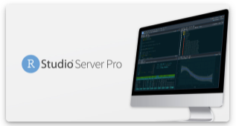
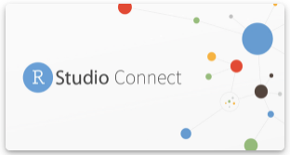

Dev
Shared

Slide 18
Thank You

